Slide 1
Credit Card Payment System
Group 1
Ujjwal Srivastava - 46071605
Vipul Vyas - 46071591
Akavarapu Rahul - 46071337
Akki Dattatreya - 46071550
Anmol Bhatia - 46071590
Vinay Reddy - 46071551

Slide 2
Table Of Contents
Case Study
Use Case
Entity Relational Mapping
Service Implementations
System Architecture
Backend Modules

Slide 3
Case Study
Create an Application for Credit card bill payment
Customer should be able to view credit card payment due date and amount.
Customer can pay the due amount bill.
Customer can view statement history.
Customer can view payment history.

Slide 4
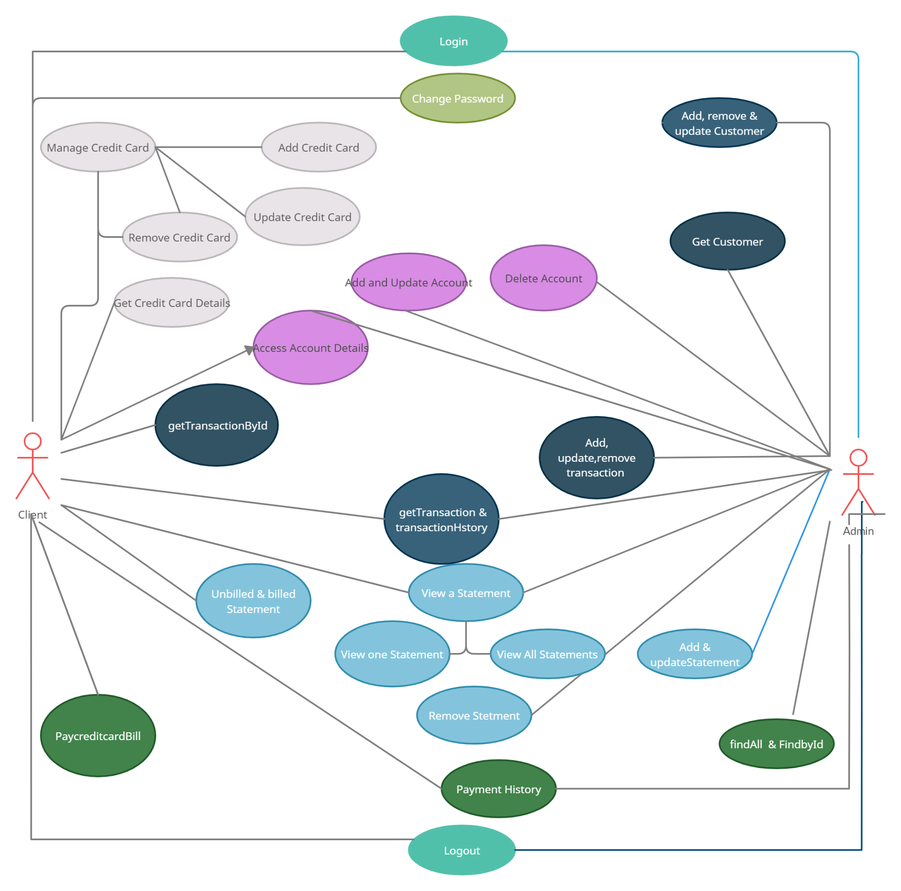
Use Case

Slide 5
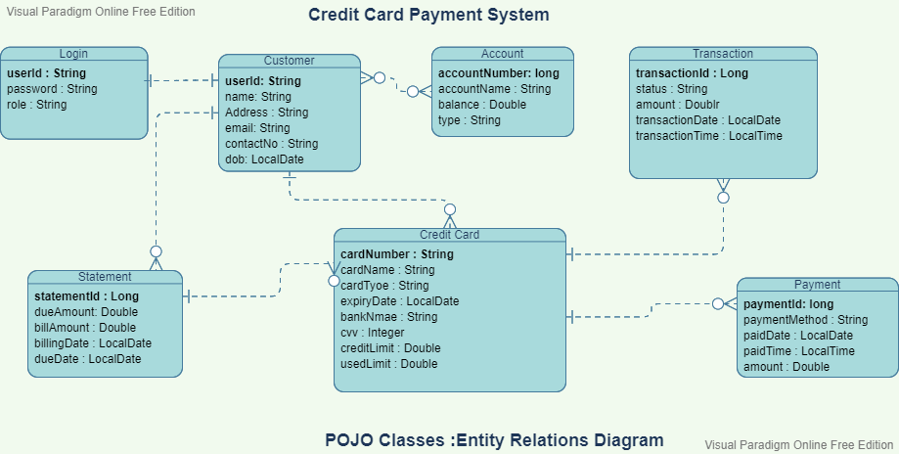
Entity Relation Mapping

Slide 6
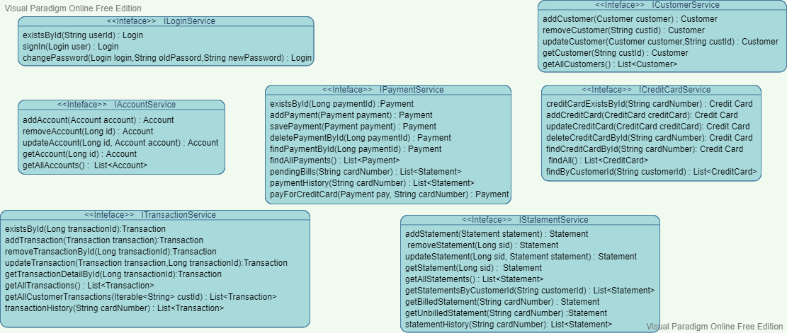
Service Implementation

Slide 7
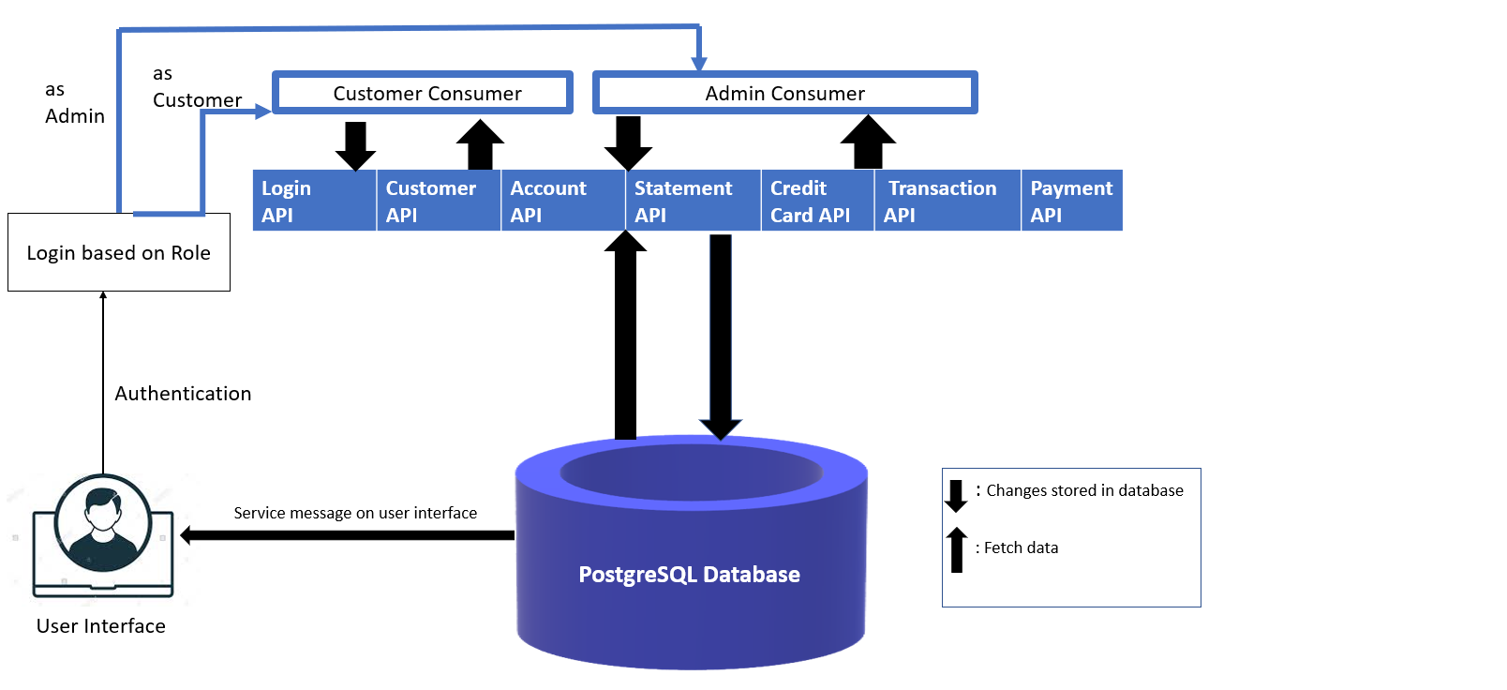
System Architecture

Slide 8
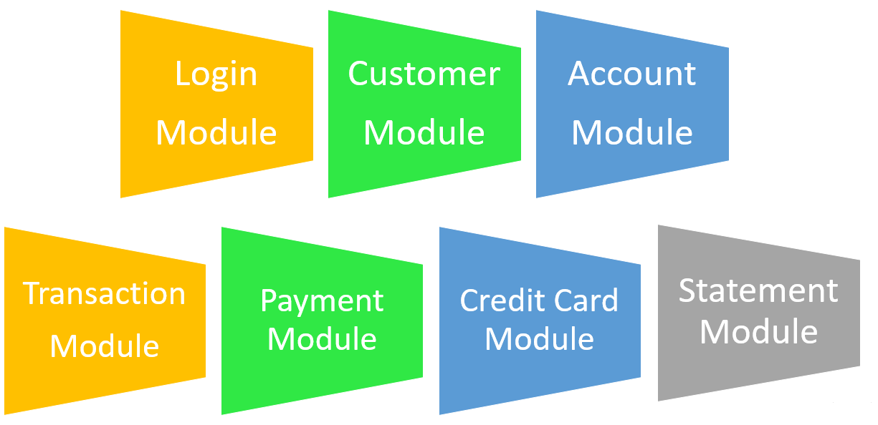
Backend Modules

Slide 9
Thank you !

